Slide 1
CloudCore
Day 2 – Data & AI

Slide 2



Alain "Lino" Tadros is a partner architect at Solliance on AI, Machine Learning and IoT for the last 4 years.
Lino provides world-class consulting, training, and software development for small, medium, and enterprise level businesses. Lino started his career in 1990 as a well-respected member of the development team at Borland for Delphi and C++Builder.
He has been awarded Microsoft MVP status 15 years in a row for his numerous contributions to the C# community and currently is recognized as a Microsoft Regional Director. Lino is also an expert in AI & Machine Learning, IoT, .NET, Azure, ASP.NET, MVC, iOS, Android, Xamarin, Sitefinity and many testing solutions.
Lino is an industry renowned speaker and has given numerous presentations in 53 countries since 1994. He currently sits on the Board of Directors of 4 Silicon Valley corporations.
You can regularly catch Lino on his LiveStream on Twitch at https://twitch.tv/linotadros
Lino Tadros
Cloud Solutions Architect
lino@solliance.net

Slide 3

Ciprian Jichici is the Chief Data Scientist of Solliance, one of the top worldwide Microsoft AI partners.
He is recognized internationally as a Microsoft Regional Director and a Microsoft Most Valuable Professional for Artificial Intelligence and Quantum Computing.
Cloud Computing, Artificial Intelligence, and Machine Learning are some of the key areas of his expertise spanning 20+ years of IT.
Ciprian is also very passionate about quantum physics and consequently, about quantum computing.
Ciprian Jichici
Chief Data Scientist
ciprian@solliance.net

Slide 4

Day 2 Rundown
Timeframe | Activity | Engagement
7:30 – 8:00 | Virtual check-in
8:00 – 9:00 | Data Fundamentals in Azure
9:00 – 11:15 | WDS: Big Data & Visualization | Interactive Discussion
11:15 – 12:00 | Lunch
12:00 – 14:00 | Team Challenge: Big Data & Visualization PoC | Interactive Discussion | Hands-on
14:00 – 14:15 | Wrap Up the Day

Slide 5
Day 2 – We are here
Timeframe | Activity | Engagement
7:30 – 8:00 | Virtual check-in
8:00 – 9:00 | Data Fundamentals in Azure
9:00 – 11:15 | WDS: Big Data & Visualization | Interactive Discussion
11:15 – 12:00 | Lunch
12:00 – 14:00 | Team Challenge: Big Data & Visualization PoC | Interactive Discussion | Hands-on
14:00 – 14:15 | Wrap Up the Day

Slide 6
Agenda
Fundamental Concepts & Patterns
Fundamental Services
Analytics
AI & Machine Learning
On-premises & Hybrid
Data Operations

Slide 7
“
Today we don’t think of aviation as ‘artificial flight’—it’s simply flight. In the same way, we shouldn’t think of technological intelligence as artificial, but rather as intelligence that serves to augment human capabilities and capacities.
”
Satya Nadella, Hit Refresh

Slide 8
Fundamental Concepts & Patterns

Slide 9
Categorizing Data By how we work with it
Operational data
Analytical data
Streaming data
Read/write data used by applications to keep current state
Examples: Order info in an ecommerce application, customer info in a CRM application
Read-only historical data used for analysis
Examples: Data warehouses, machine learning data
Data produced and processed in real time
Examples: Internet of Things (IoT), e.g., sensor data

Slide 10
Lambda architecture
Speed Layer
Input Data
Analytics Client
Real-Time Views
“Hot” Path
Batch Layer
Serving Layer
Master Data
Batch Views
“Cold” Path

Slide 11
Key Data Architectures
Modern DW
“We want to incorporate all of our data including ‘big data’ with our data warehouse”
Advanced Analytics
“We are trying to predict when our customers churn.”
Stream Analytics
“We are trying to get insights from our devices in real-time, etc.”

Slide 12







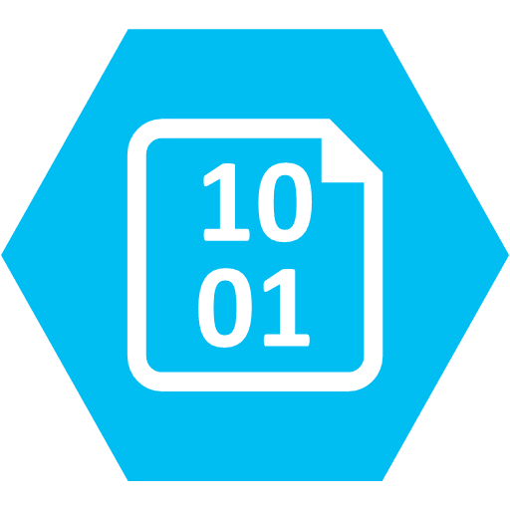


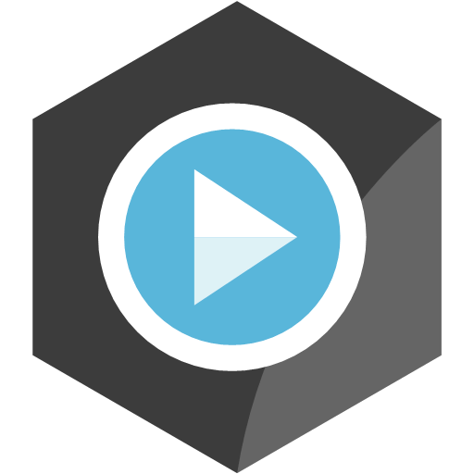

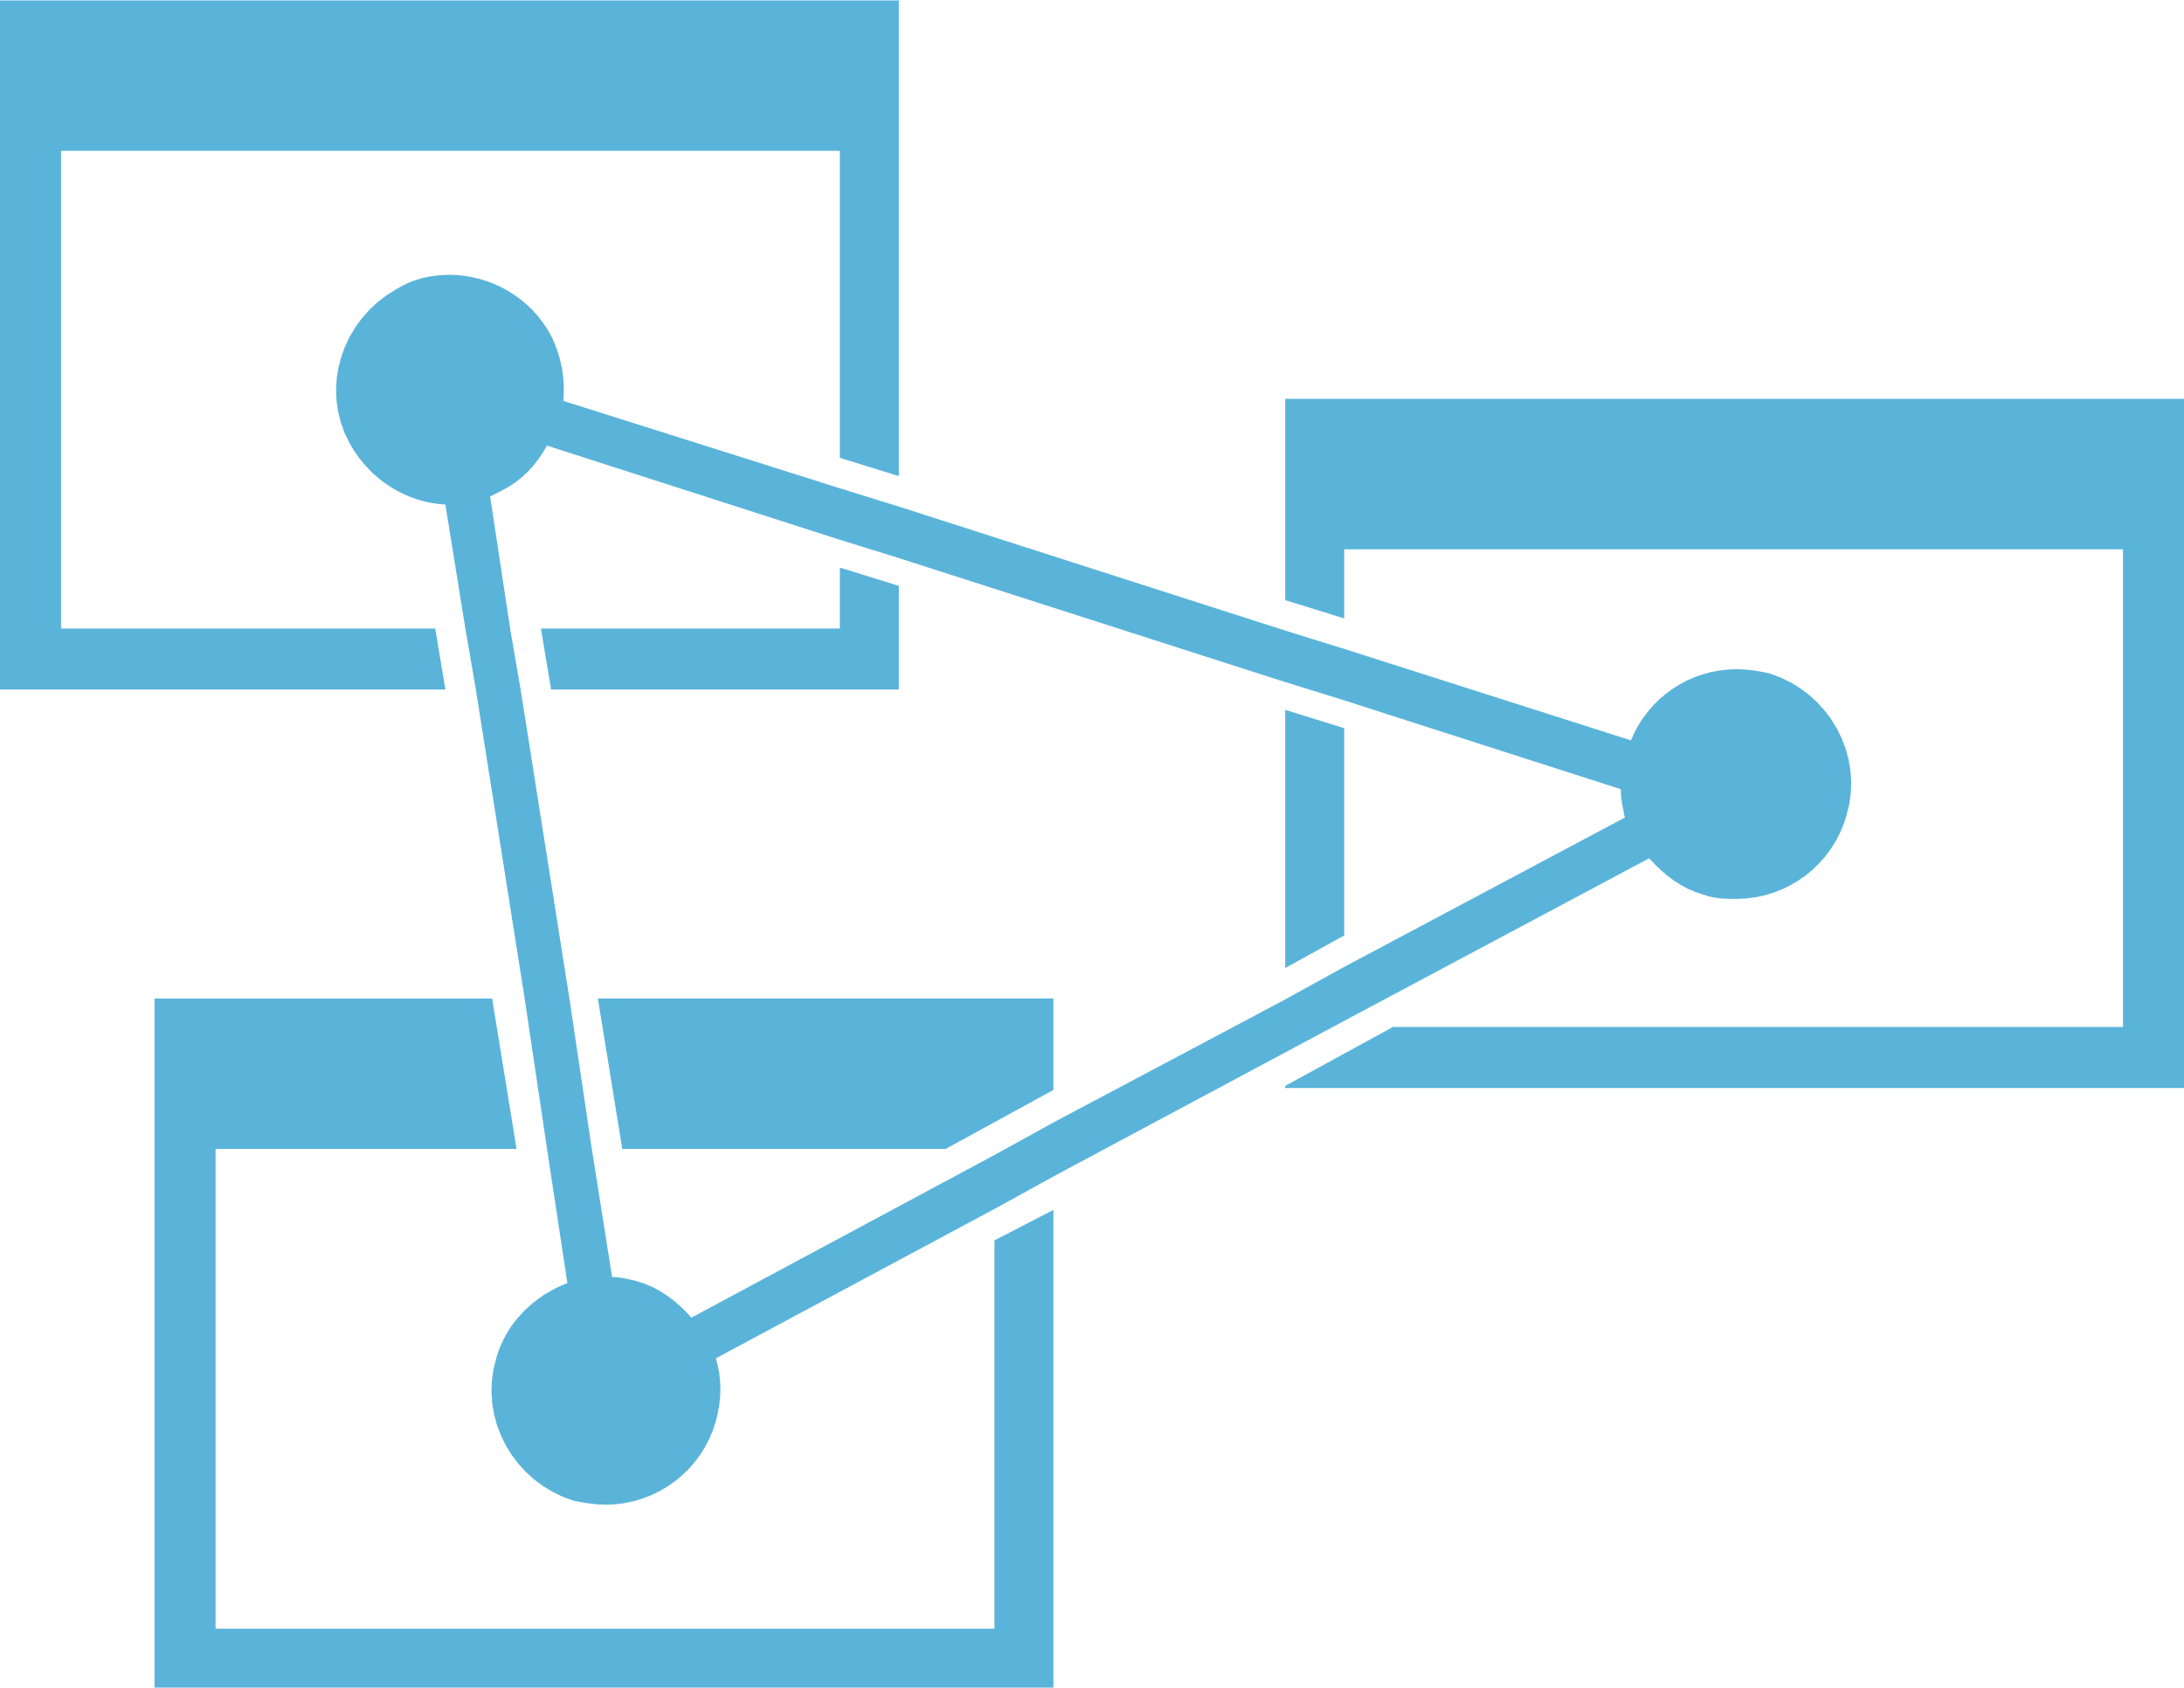
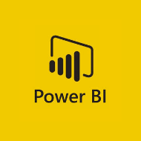
Data Warehousing Pattern in Azure
Loading and preparing data for analysis with a data warehouse
DATA LOADING
DATA FACTORY
Azure Import/Export Service
Azure Data Box
API’s, CLI & GUI Tools
SERVING STORAGE
DATA PROCESSING
INGEST STORAGE
APPLICATIONS
r
SQL DW
SQL DB
DATA LAKE ANALYTICS
AZURE DATABRICKS
LOGS, FILES AND MEDIA (UNSTRUCTURED)
DATA LAKE STORE
AZURE STORAGE
AZURE ANALYSIS SERVICES
HDINSIGHT
SQL DW
BUSINESS / CUSTOM APPS
(STRUCTURED)
DASHBOARDS
DATA FACTORY
ORCHESTRATION
Notes:
In modern data warehousing, data may be collected from various sources including flat files that are uploaded to storage like Data Lake Store or Azure Storage, or the source data may come from applications that are writing to one more transaction databases.
These “ingest stores” form the source for the data that is processed and ultimately served to applications and dashboards either in a data warehouse or by an analytic store that gets its data from the data warehouse.
It is worth observing that the modern data warehouse can serve two functions. It can participate in the data processing in addition to being the data store serving analytic clients.

Slide 13
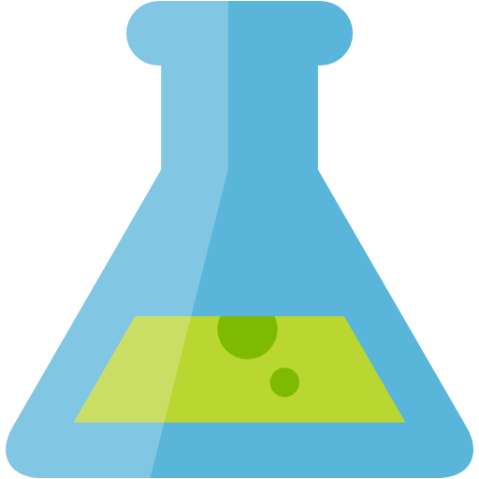








Advanced analytics pattern in Azure
Perform data collection/understanding, modeling and deployment
MODEL TRAINING
SERVING STORAGE
AZURE ML
AZURE ML STUDIO
ML SERVER
AZURE DATABRICKS (Spark ML)
SQL Server (In-database ML)
DATA SCIENCE VM
BATCH AI
SENSORS AND IOT
(UNSTRUCTURED)
COSMOS DB
LONG TERM STORAGE
DATA PROCESSING
APPLICATIONS
SQL DB
r
LOGS, FILES AND MEDIA (UNSTRUCTURED)
SQL DB
SQL DW
DATA LAKE STORE
AZURE STORAGE
COSMOS DB
DATA LAKE ANALYTICS
AZURE DATABRICKS
HDINSIGHT
ORCHESTRATION
TRAINED MODEL HOSTING
AZURE ANALYSIS SERVICES
BUSINESS / CUSTOM APPS
(STRUCTURED)
SQL Server (In-database ML)
DASHBOARDS
AZURE CONTAINER SERVICE
DATA FACTORY

Slide 14
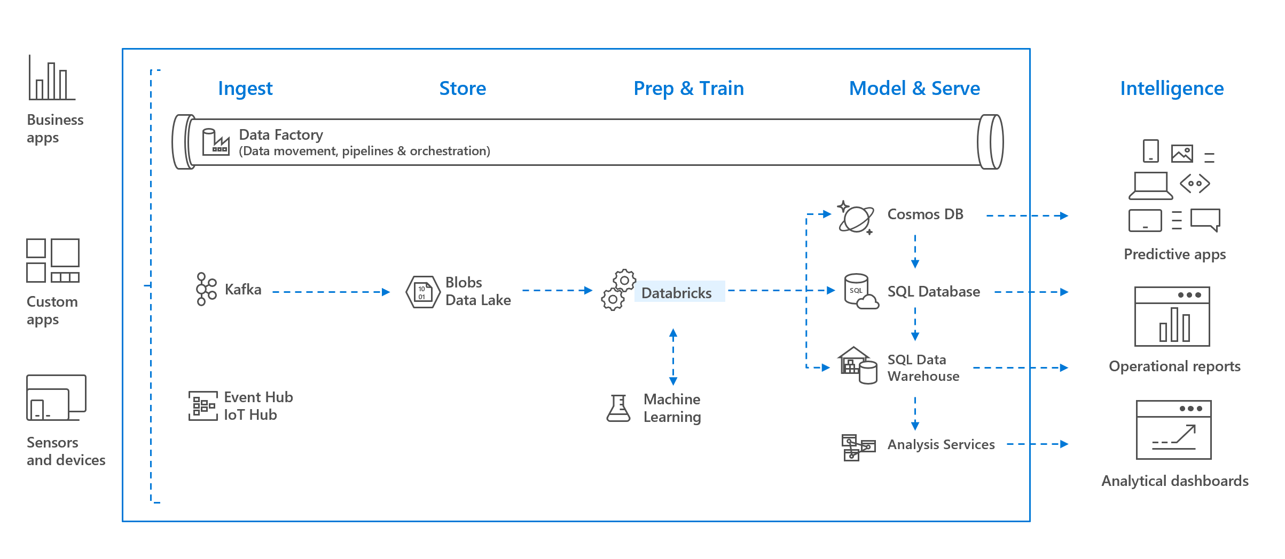
Streaming pattern

Slide 15
Fundamental Services

Slide 16
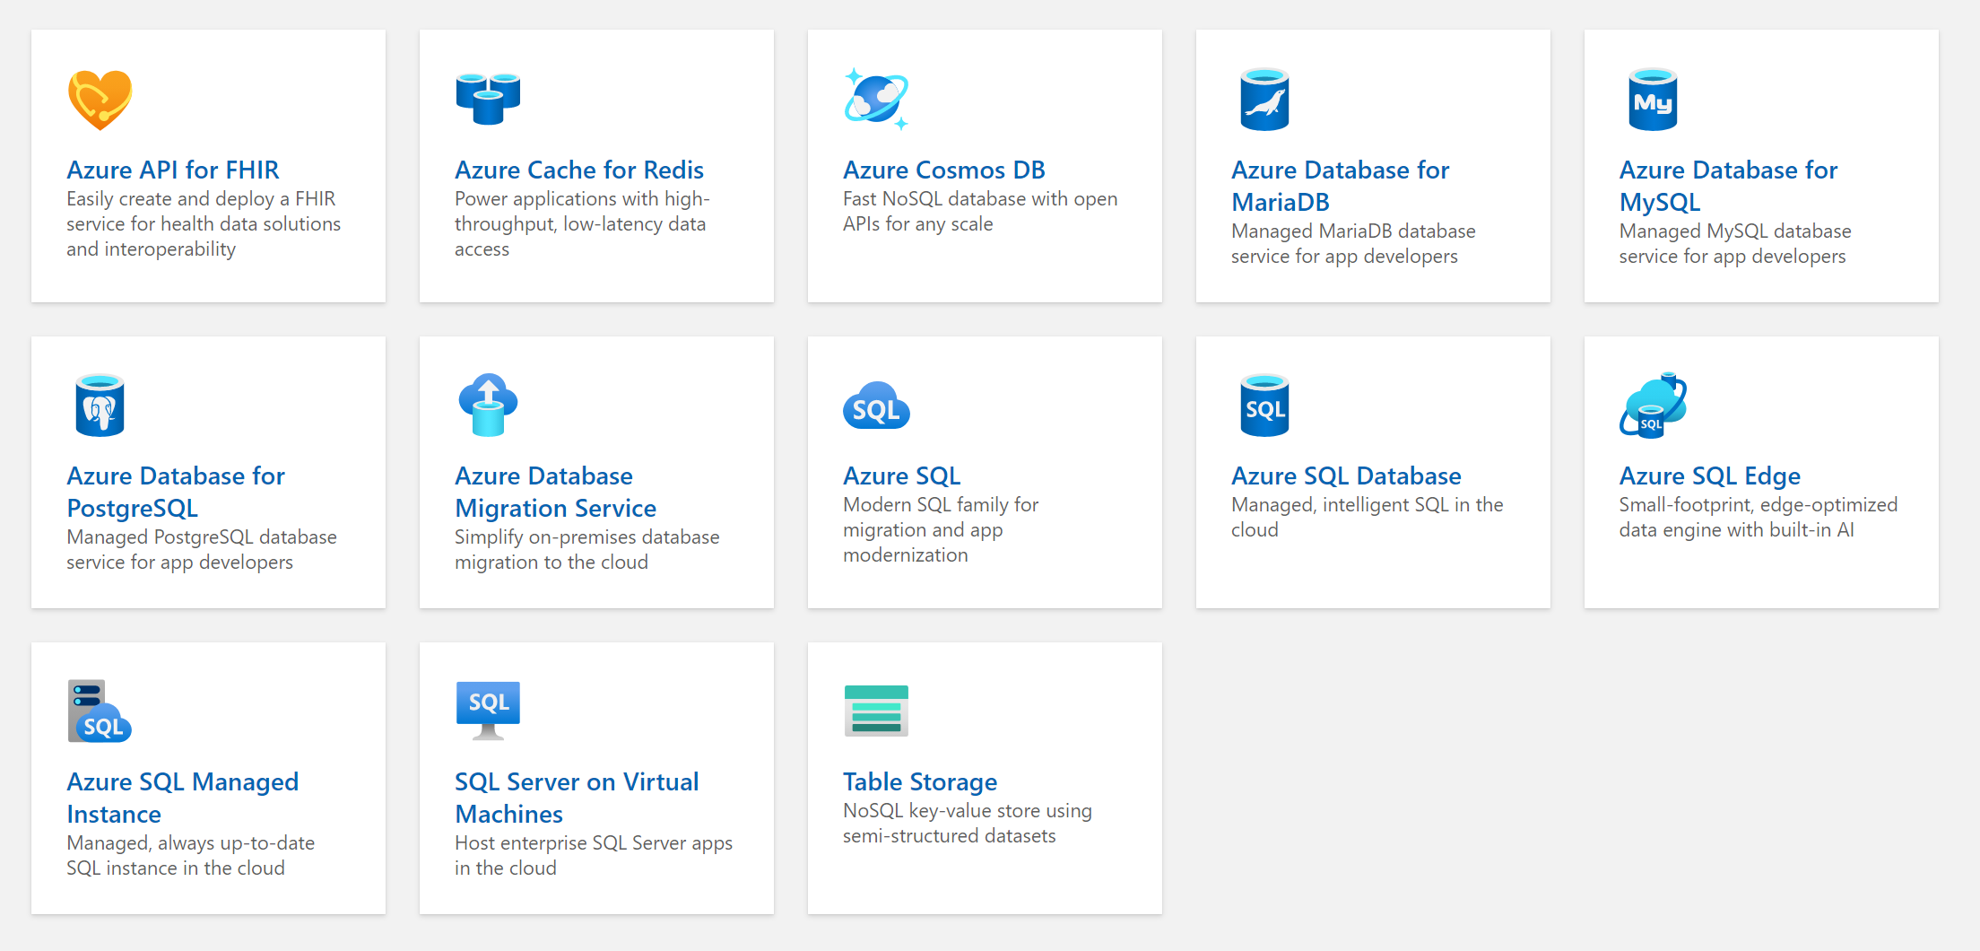
Databases

Slide 17
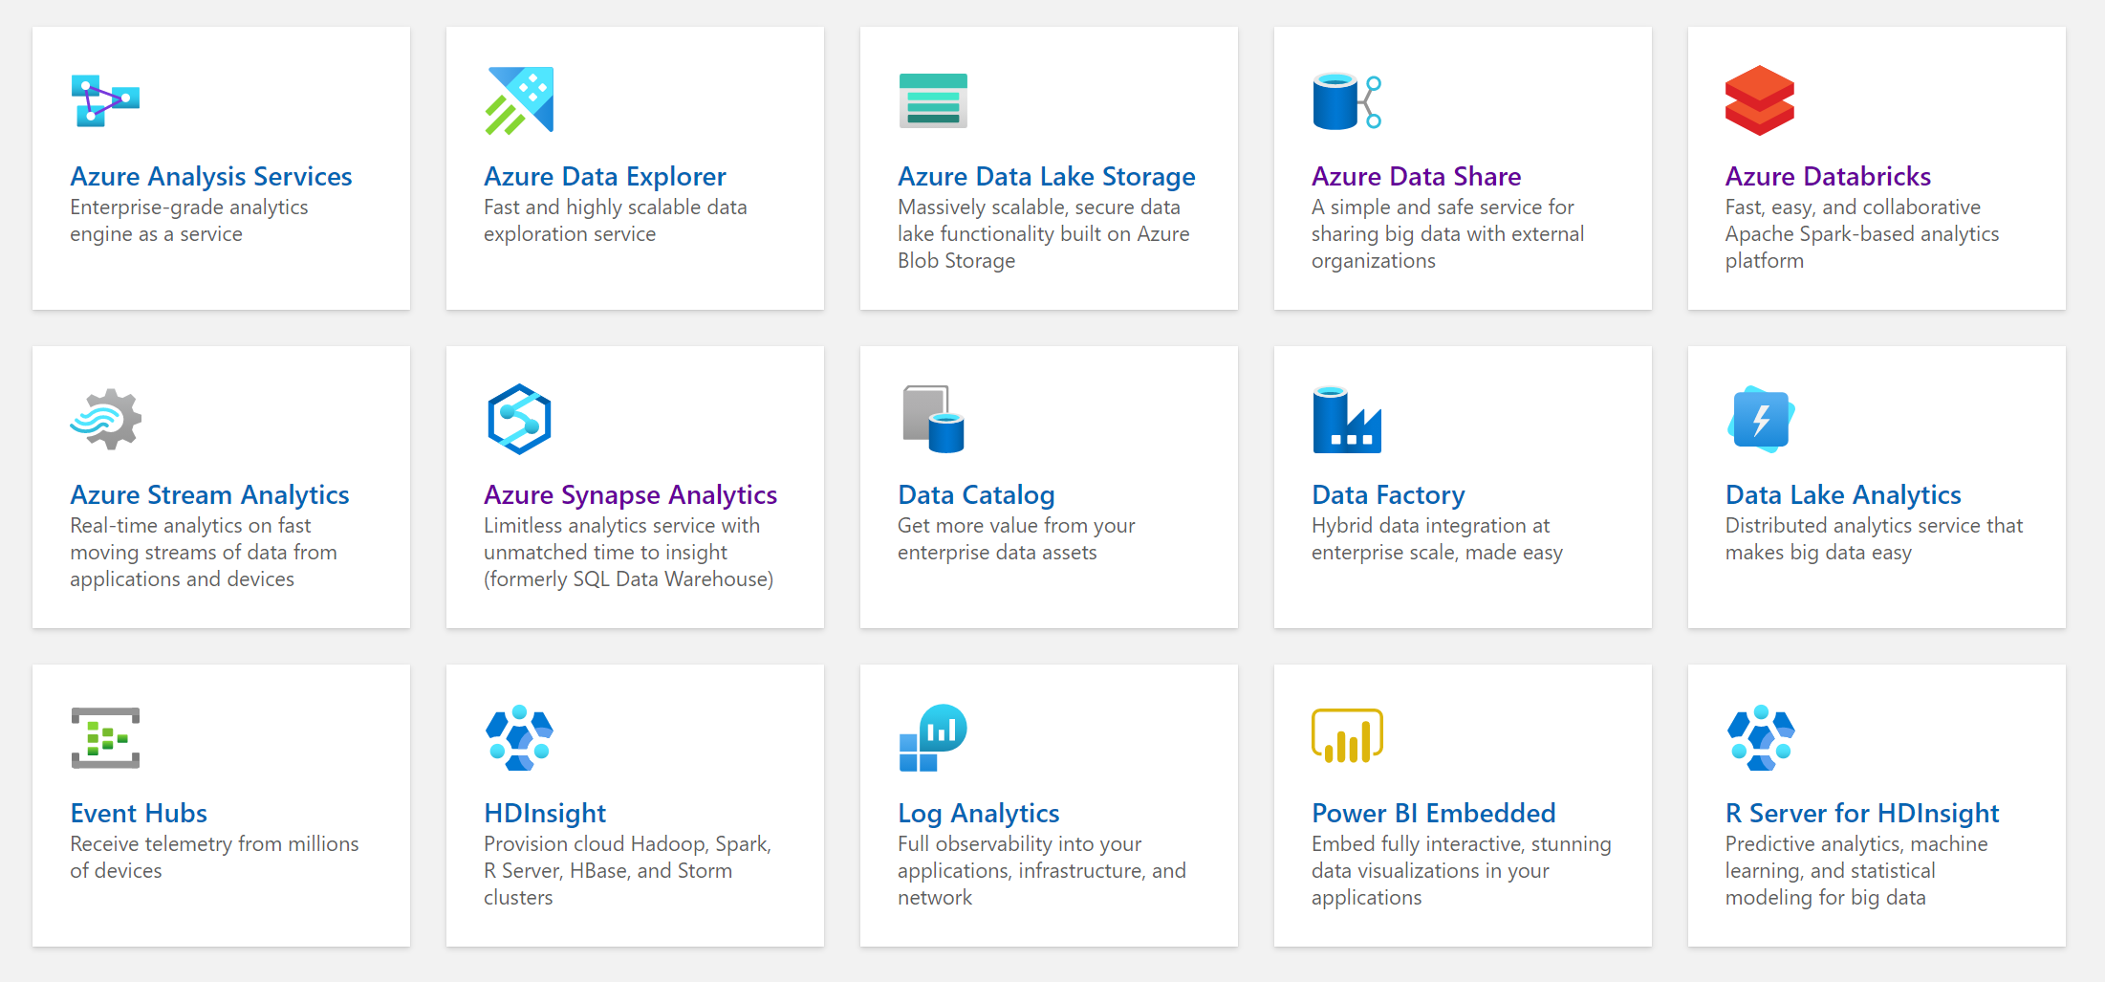
Analytics

Slide 18
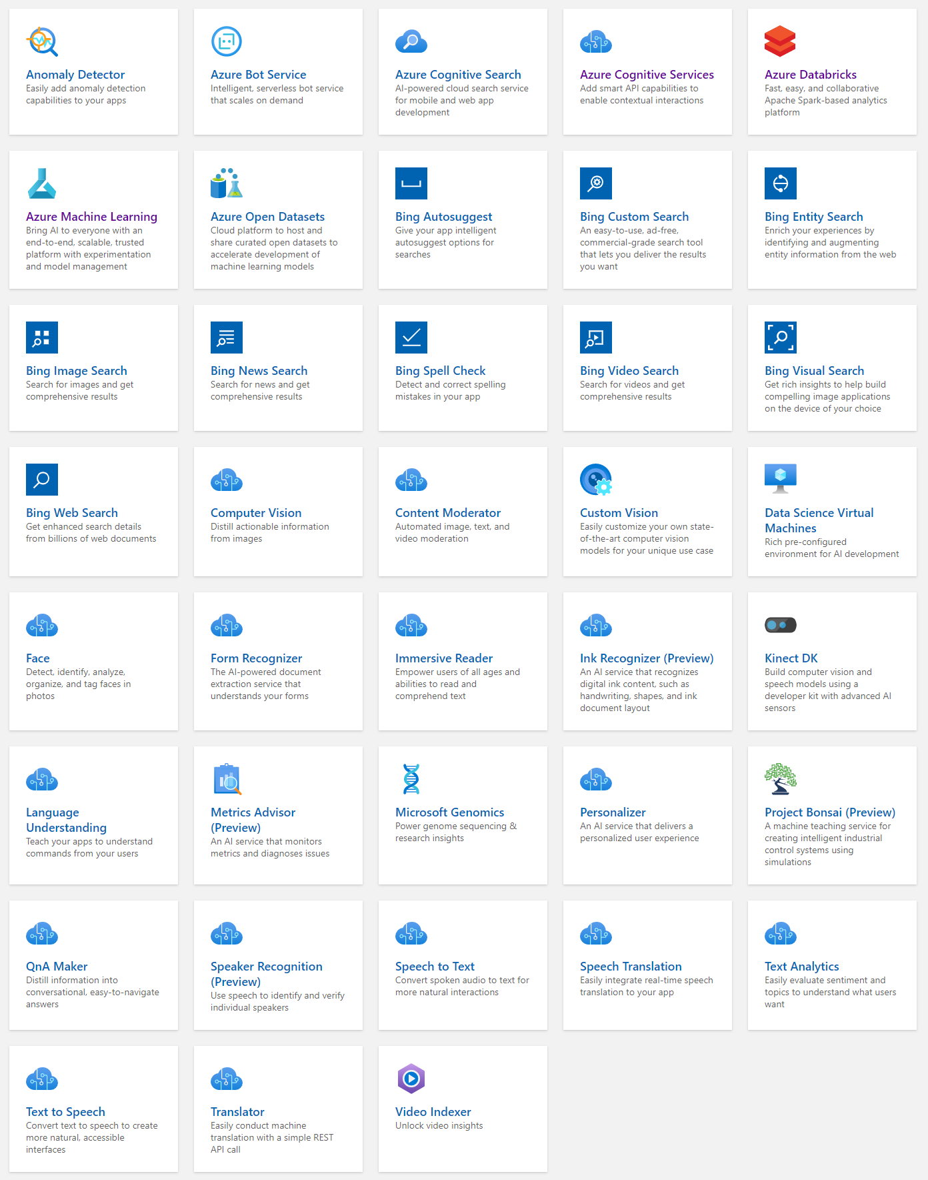
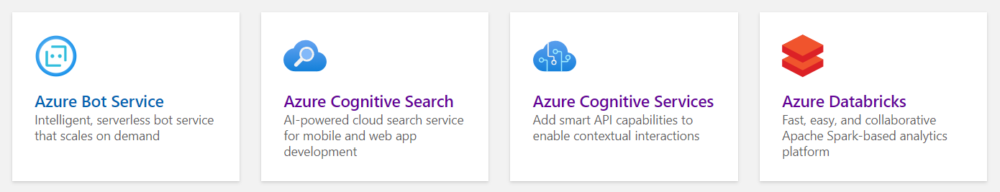
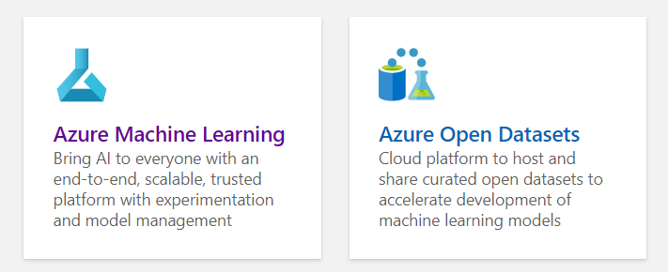
AI + Machine Learning

Slide 19
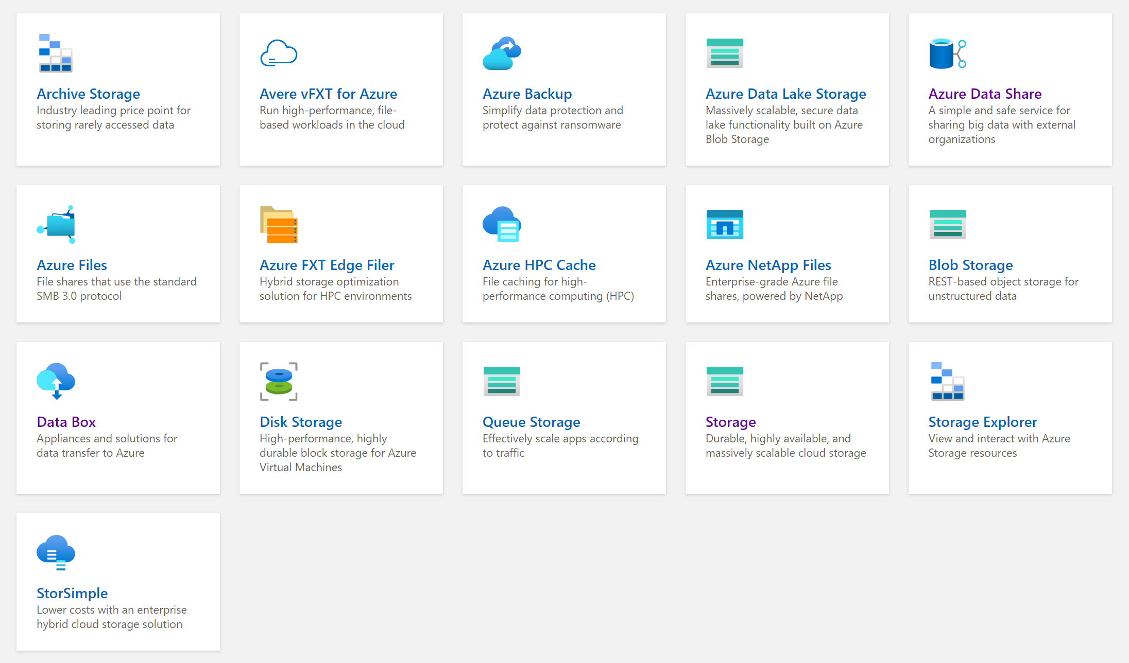
Storage

Slide 20
Analytics

Slide 21
Modern Data Warehouse
INGEST
PREPARE
TRANSFORM & ENRICH
SERVE
VISUALIZE
STORE

Slide 22









Modern Data Warehouse
INGEST
PREPARE
TRANSFORM & ENRICH
SERVE
VISUALIZE
AZURE SYNAPSE ANALYTICS
Synapse SQL (Provisioned)
Synapse Pipeline
Synapse SQL (Provisioned)
Data Sources
Synapse SQL (Serverless)
Synapse Pipeline
Power BI
OR
OR
Synapse Pipelines
Synapse SQL (Serverless)
Synapse Spark
Synapse Spark
Synapse SQL (Serverless)
STORE
ADLS Gen 2
Storage Account
Data Lake
Notes:
To do: remove exclusive Synapse Analytics references, include Databricks as well

Slide 23

Azure Synapse Analytics
Designed for analytics workloads at any scale
Limitless analytics service with unmatched time to insight
SaaS developer experiences for code free and code first
Artificial Intelligence / Machine Learning / Internet of Things
Intelligent Apps / Business Intelligence
Synapse Analytics
Multiple languages suited to different analytics workloads
Experience
Azure Synapse Studio
Platform
Integrated analytics runtimes available provisioned and serverless on-demand
SQL Analytics offering T-SQL for batch, streaming and interactive processing
Spark for big data processing with Python, Scala, R and .NET
MANAGEMENT
Languages
MANAGEMENT
SQL
Python
.NET
Java
Scala
R
SECURITY
Form Factors
SECURITY
PROVISIONED
SERVERLESS
MONITORING
Analytics Runtimes
MONITORING
SQL
METASTORE
METASTORE
DATA INTEGRATION
Azure
Data Lake Storage
Integrated platform services for, management, security, monitoring, and metastore
Common Data Model
Enterprise Security
Optimized for Analytics
Data lake integrated and Common Data Model aware

Slide 24
Apache Spark
A unified, open source, parallel, data processing framework for Big Data Analytics
Spark Unifies:
Batch Processing
Interactive SQL
Real-time processing
Machine Learning
Deep Learning
Graph Processing
Spark SQL
Batch processing
Spark ML/MLlib
Machine Learning
Spark Streaming
Stream processing
GraphX
Graph Computation
Spark Core Engine
Yarn
Spark MLlib
Machine Learning
Spark Structured Streaming
Stream processing
http://spark.apache.org
Notes:
Spark SQL
Unified data access: Query structured data sets with SQL or DataFrame APIs
Fast, familiar query language across all your enterprise data
Use BI tools to connect and query via JDBC or ODBC drivers
MLlib & SparkML
Predictive and prescriptive analytics
Machine learning algorithms for:
Clustering
Classification
Regression
etc.
Smart application design from pre-built, out-of-the-box statistical and algorithmic models
Spark Streaming
Micro-batch event processing for near-real time analytics
e.g. Internet of Things (IoT) devices, Twitter feeds, Kafka (event hub), etc.
Spark’s engine drives some action or outputs data in batches to various data stores
GraphX
Represent and analyze systems represented by graph nodes
Trace interconnections between graph nodes
Applicable to use cases in transportation, telecommunications, road networks, modeling personal relationships, social media, etc.

Slide 25
General Spark Cluster Architecture
‘Driver’ runs the user’s ‘main’ function and executes the various parallel operations on the worker nodes.
The results of the operations are collected by the driver
The worker nodes read and write data from/to Data Sources including HDFS.
Worker node also cache transformed data in memory as RDDs (Resilient Distributed Datasets).
Worker nodes and the Driver Node execute as VMs in public clouds (AWS, Google and Azure).
Driver Program SparkContext
Cluster Manager
Node
Node
Node
Cache
Cache
Cache
Task
Task
Task
Data Sources (HDFS, SQL, NoSQL, …)

Slide 26

Azure Synapse Apache Spark - Summary
Apache Spark 2.4 derivation
Linux Foundation Delta Lake 0.4 support
.Net Core 3.0 support
Python 3.6 + Anaconda support
Tightly coupled to other Azure Synapse services
Integrated security and sign on
Integrated Metadata
Integrated and simplified provisioning
Integrated UX including nteract based notebooks
Fast load of SQL Analytics pools
Core scenarios
Data Prep/Data Engineering/ETL
Machine Learning via Spark ML and Azure ML integration
Extensible through library management
Efficient resource utilization
Fast Start
Auto scale (up and down)
Auto pause
Min cluster size of 3 nodes
Multi Language Support
.Net (C#), PySpark, Scala, Spark SQL, Java

Slide 27
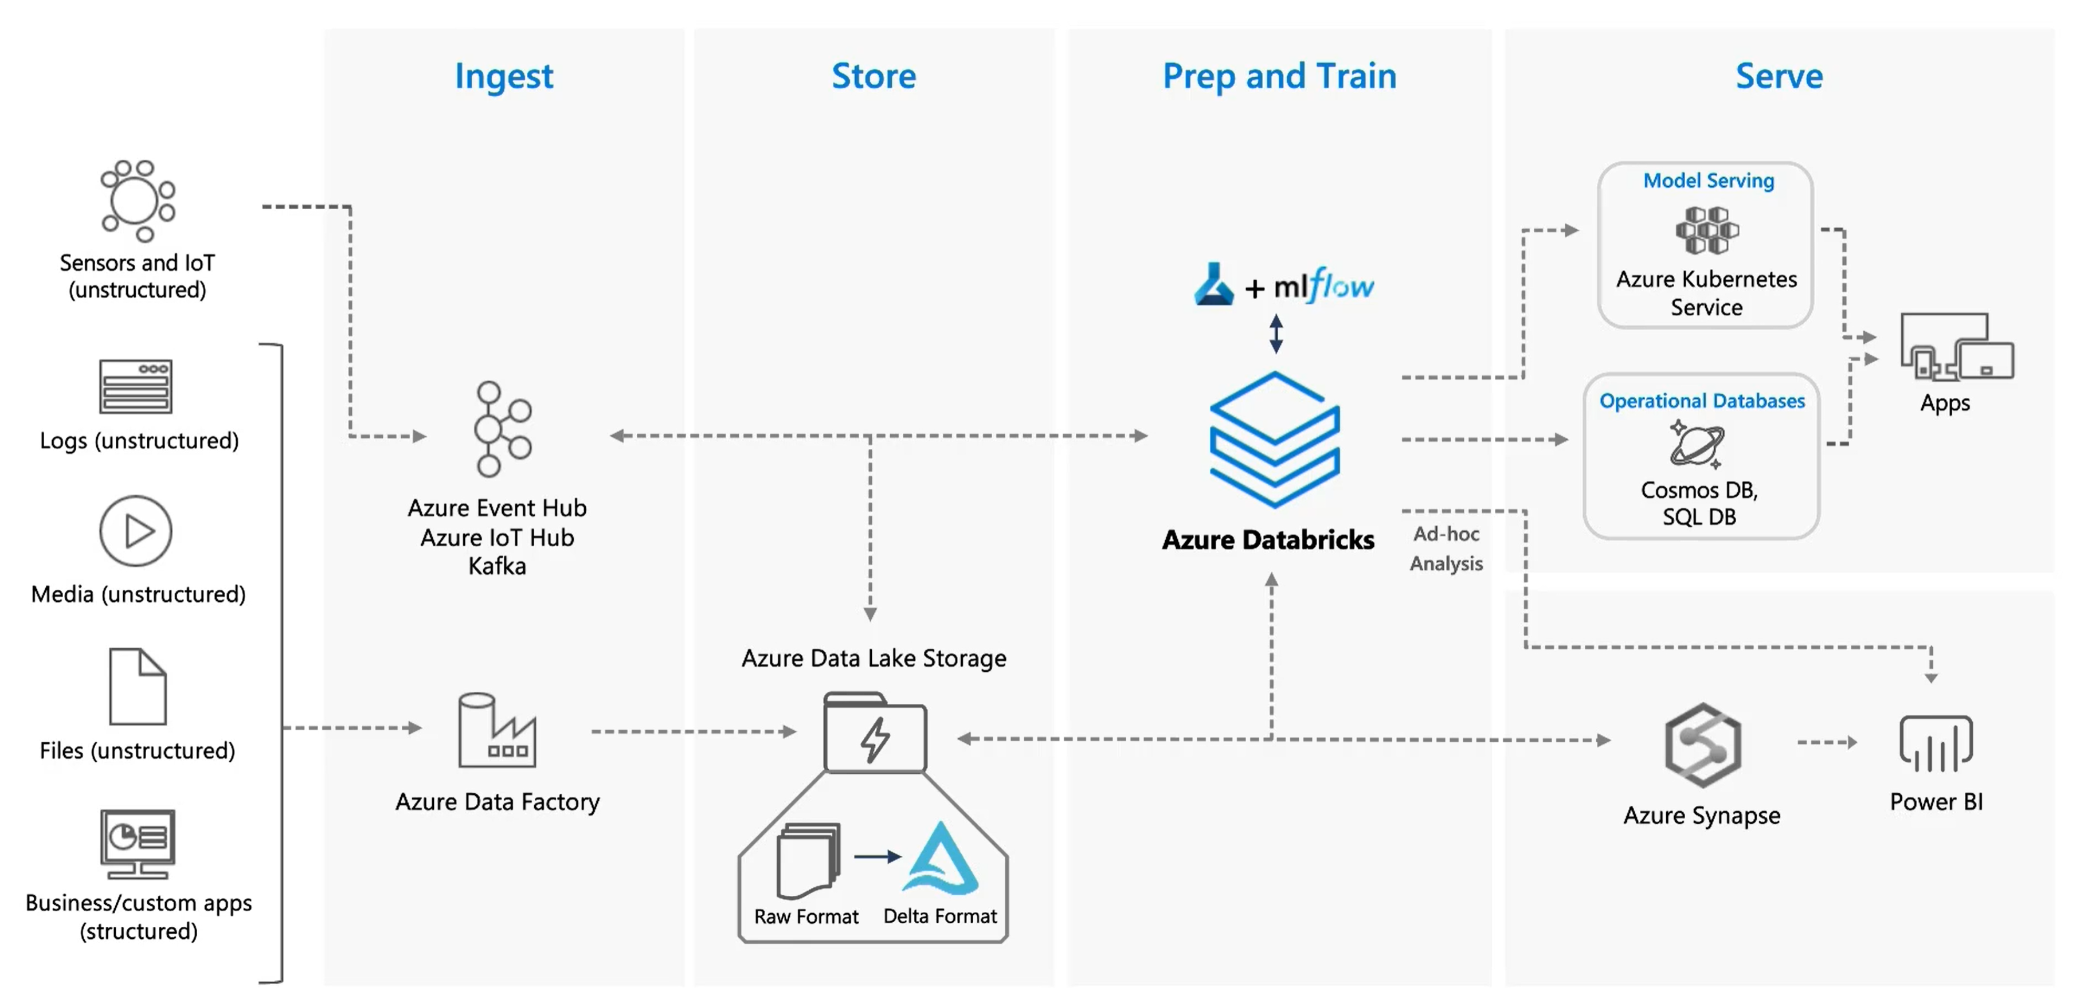
Azure Databricks

Slide 28
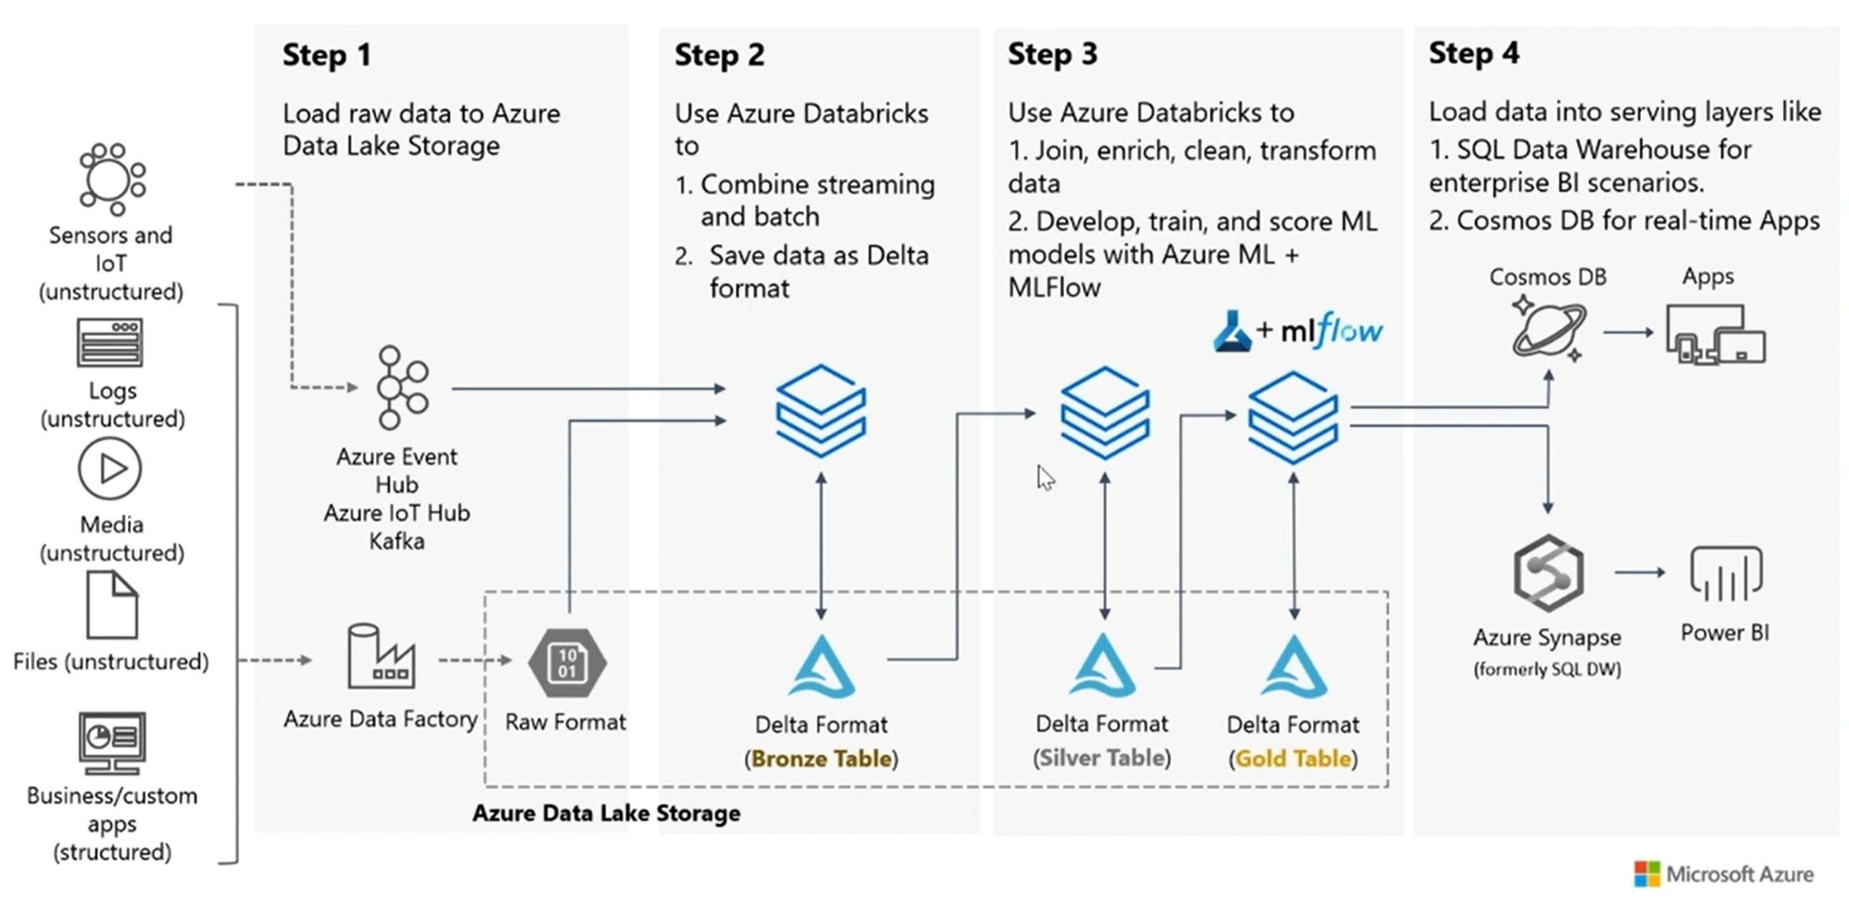
Azure Databricks – Delta Lake

Slide 29
Artificial Intelligence & Machine Learning

Slide 30

Image credit: https://developer.nvidia.com/deep-learning

Slide 31
The Pre-Built and Custom AI Spectrum
Pre-Built AI
Custom AI
Azure Cognitive Services
Azure Machine Learning
Pre-built models
Custom models
Models are pre-trained using Microsoft supplied data
Models “customized” with your data
Models tailored to your scenario and your data

Slide 32
The Data Science Process
Collect Data
Prepare Data
Train Model
Evaluate Model
Deploy Model
Re-train
Model
Notes:
Collect Data
Prepare Data
Perform data wrangling to get the data in a format suitable for analysis
Explore and understand the data
Identify or create the features needed for your model
Train Model
Select the algorithm
Prepare training, testing and validation data sets
Iteratively evaluate model to identify best performing version and sanity check outcome
Evaluate Model
Run the model thru a final exam using data from your validation data set and see how it performs
Deploy the Model
Package the model and dependencies up for deployment
Use it in a web service or within an API in an application
Measure the ongoing performance of the model
Retrain
As the data environment changes and affect model performance, retrain the model on fresh data

Slide 33
The Data Science Process (Developer Lens)
Collect Data
Prepare Data
Train Model
Evaluate Model
Deploy Model
Re-train
Model
Write Code
Write Queries & Code
Write Code Do some math
Write Code Do some math
Do DevOps

Slide 34
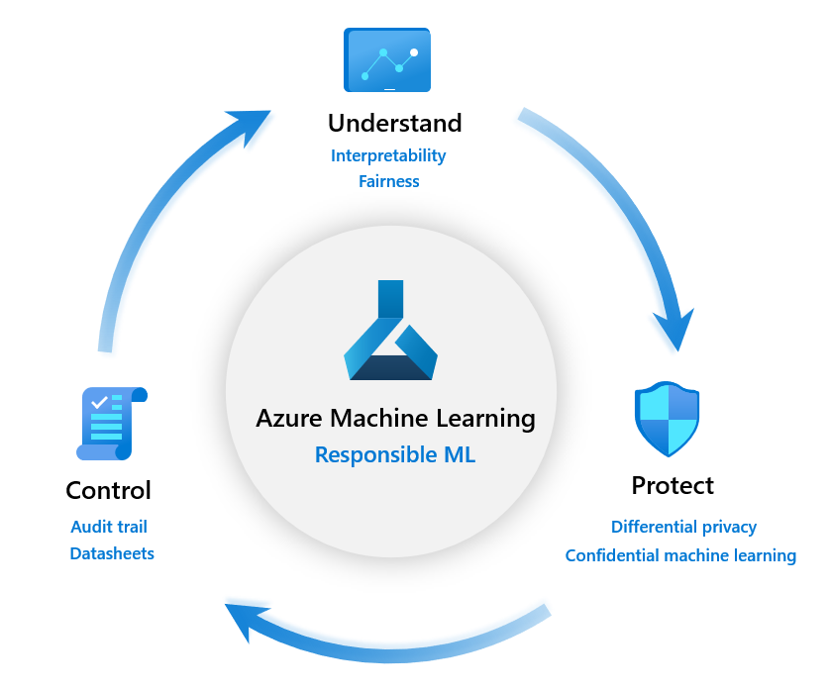

Slide 35
Design AI to earn and maintain trust
z
Fairness
Reliability
& Safety
Privacy & Security
Inclusiveness
Transparency
Accountability
Notes:
It boils down to trust
If people don’t trust AI solutions, then they won’t use them and they won’t support their development
These are the values an AI system needs to respect:
Fairness – AI systems should treat all people fairly.
Reliability – AI systems should perform reliably and safely.
Privacy & Security – AI systems should be secure and respect privacy.
Inclusiveness – AI systems should empower everyone and engage people.
These four value are built on a foundation of:
Transparency – AI systems should be understandable.
Accountability - the people who design and deploy AI systems must be accountable for how their systems operate.

Slide 36
On-premises & hybrid

Slide 37
SQL 2019 - Big Data Analytics
deployed on Azure Stack
Data virtualization
Managed SQL Server, Spark and data lake
Complete AI platform
Analytics
Apps
Admin portal and management services
Integrated AD-based security
T-SQL
External data sources
SQL Server
External Tables
SQL Server
Spark
Compute pools and data pools
SQL Server
ML Services
Spark & Spark ML
Scalable, shared storage (HDFS)
External data sources
HDFS
Open database connectivity
NoSQL
Relational databases
HDFS
Combine data from many sources without moving or replicating it
Scale out compute and caching to boost performance
Store high volume data in a data lake and access it easily using either SQL or Spark
Management services, admin portal, and integrated security make it all easy to manage
Easily feed integrated data from many sources to your model training
Ingest and prep data and then train, store, and operationalize your models all in one system

Slide 38
Data Operations

Slide 39
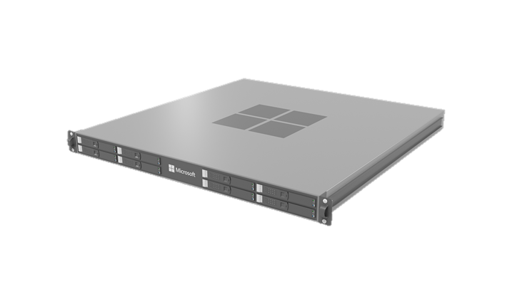
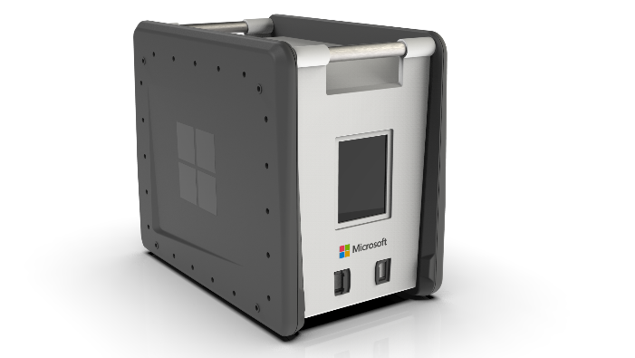
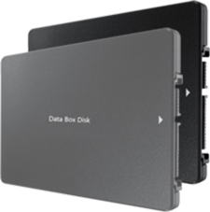
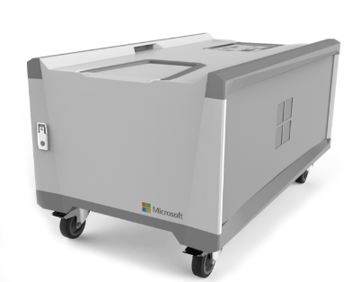

Azure Data Box Family
Transfer via shipping
Transfer via network
Data Box
Secure, ruggedized data transport appliance.
Capacity: 100 TB;
Size: ~50 lbs
Data Box Disk
Secure, ruggedized USB drives which can be ordered in packs of 5
Capacity: 8 TB disks up to 40 TB per order
Data Box Heavy
Large-scale, secure, ruggedized appliance
Capacity: 1 PB;
Weight 500+ lbs
Targeted to very large data sets
Data Box Gateway
Virtual network transfer appliance
Runs as a VM on choice of hardware
Stack Edge
(Data Box Edge)
Rack-able data transfer appliance with compute
AI-enabled compute to analyze, transform, and pre-process data before the transfer
Local Cache: ~12 TB
Includes Data Box Gateway and Azure IoT Edge

Slide 40
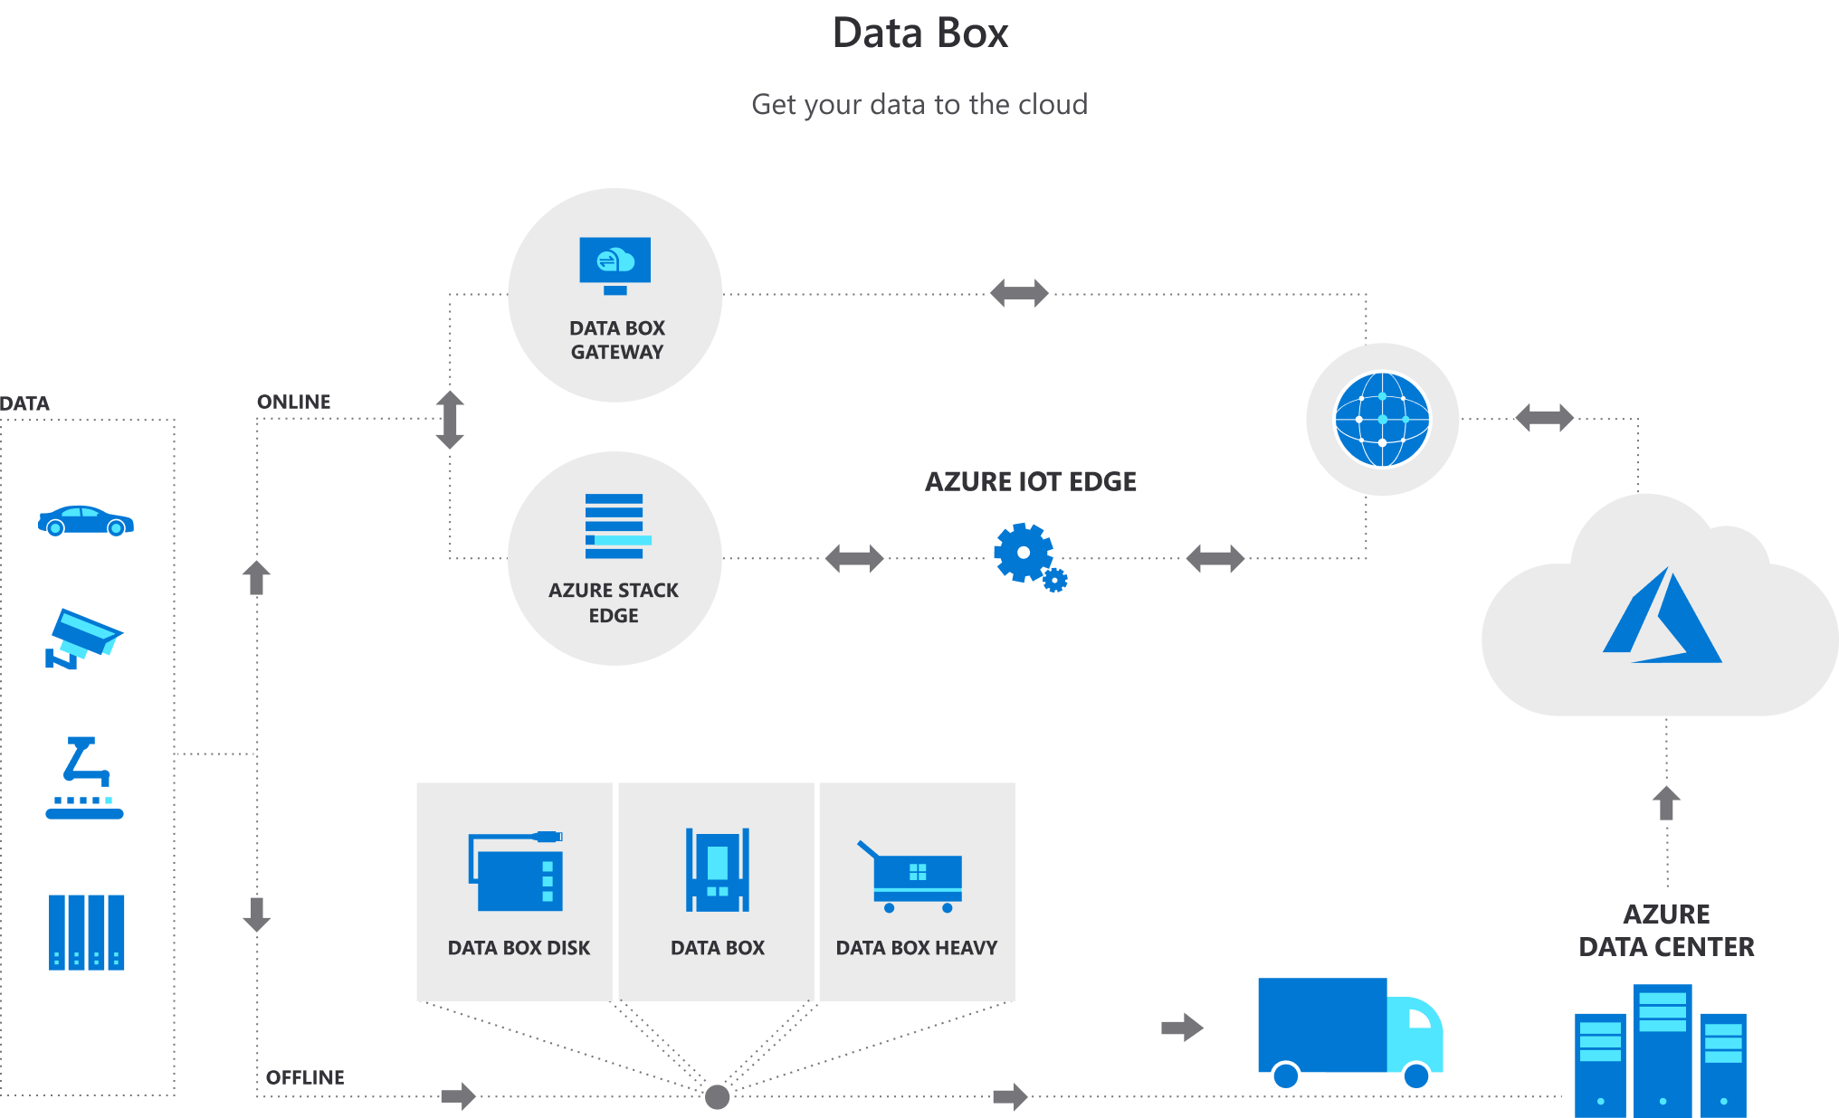
Data Operations

Slide 41


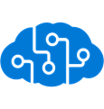

Azure Stack Edge
Transfer data over network to Azure
Transfer data to Azure to enable further compute and analytics or for archival purposes
Preprocess data
Transform data before sending it to Azure to create a more actionable dataset
Inference with Azure Machine Learning
Run ML models to get quick results that can be acted on before the data is sent to the cloud
An AI-enabled edge computing appliance with network data transfer capabilities
Microsoft Appliance
Acquire and manage directly from the Azure portal as part of a monthly meter

Slide 42
Day 2 – We are here
Timeframe | Activity | Engagement
7:30 – 8:00 | Virtual check-in
8:00 – 9:00 | Data Fundamentals in Azure
9:00 – 11:15 | WDS: Big Data & Visualization | Interactive Discussion
11:15 – 12:00 | Lunch
12:00 – 14:00 | Team Challenge: Big Data & Visualization PoC | Interactive Discussion | Hands-on
14:00 – 14:15 | Wrap Up the Day

Slide 43
Next: Whiteboard Design Session
GitHub repo for the Whiteboard Design Session:
https://github.com/solliancenet/cloudcore-2020-data-ai
The WDS material is found under day-2/wds

Slide 44
Day 2 – We are here
Timeframe | Activity | Engagement
7:30 – 8:00 | Virtual check-in
8:00 – 9:00 | Data Fundamentals in Azure
9:00 – 11:15 | WDS: Big Data & Visualization | Interactive Discussion
11:15 – 12:00 | Lunch
12:00 – 14:00 | Team Challenge: Big Data & Visualization PoC | Interactive Discussion | Hands-on
14:00 – 14:15 | Wrap Up the Day

Slide 45
Day 2 - We are here
Timeframe | Activity | Engagement
7:30 – 8:00 | Virtual check-in
8:00 – 9:00 | Data Fundamentals in Azure
9:00 – 11:15 | WDS: Big Data & Visualization | Interactive Discussion
11:15 – 12:00 | Lunch
12:00 – 14:00 | Team Challenge: Big Data & Visualization PoC | Interactive Discussion | Hands-on
14:00 – 14:15 | Wrap Up the Day

Slide 46
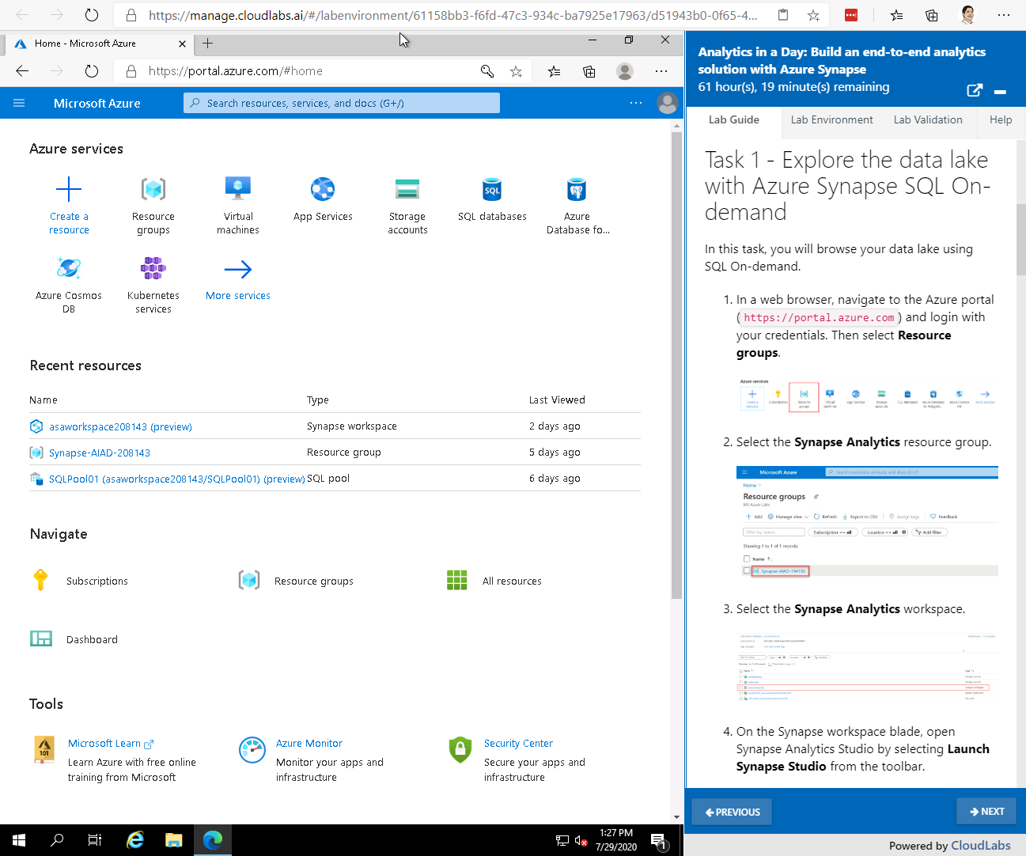
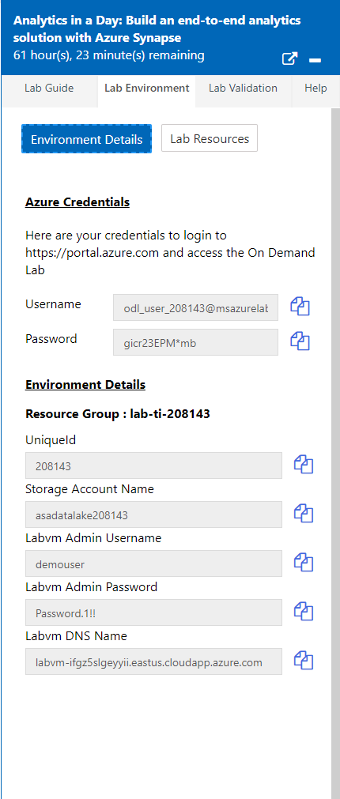
Next: Lab Experience
Lab can provide a VM with software preinstalled
Each attendee has a dedicated lab environment:
https://manage.cloudlabs.ai/#/odl/6029acfe-d79e-4077-b8cb-96c44626ce0a/79d95799-89dd-469b-b2eb-ef92fbd531ad
Lab Guide is in markdown
and pulled from GitHub
Each link is unique to the attendee.
GitHub repo for the lab:
https://github.com/solliancenet/cloudcore-2020-data-ai
The challenge guide is found under day-2/challenge
Azure credentials and other environment details in Lab Environment tab

